Slide 1


Presented by Ajay Meena
Analyzing Kickstarter: Insights and Recommendations
Exploring Project Success Rates and Strategies for Improvement

Slide 2
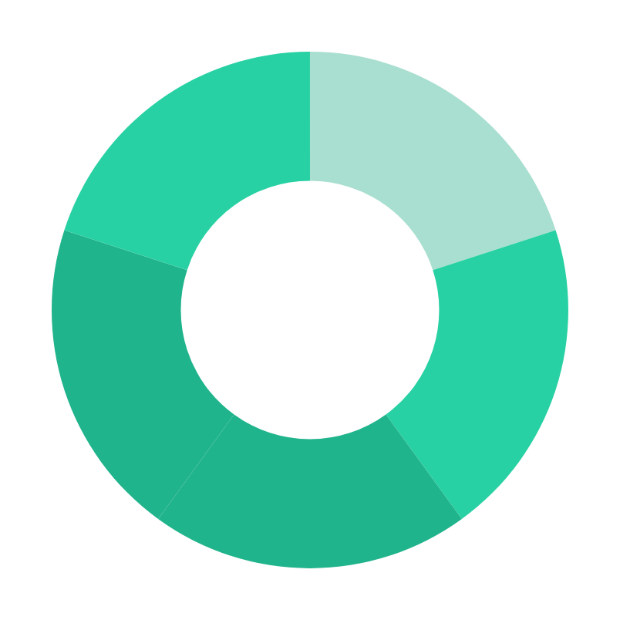
Introduction
"Kickstarter is a platform where creative ideas come to life through community support and crowdfunding.
Our analysis aims to uncover strategies to boost project success rates based on the findings of our project."

Slide 3
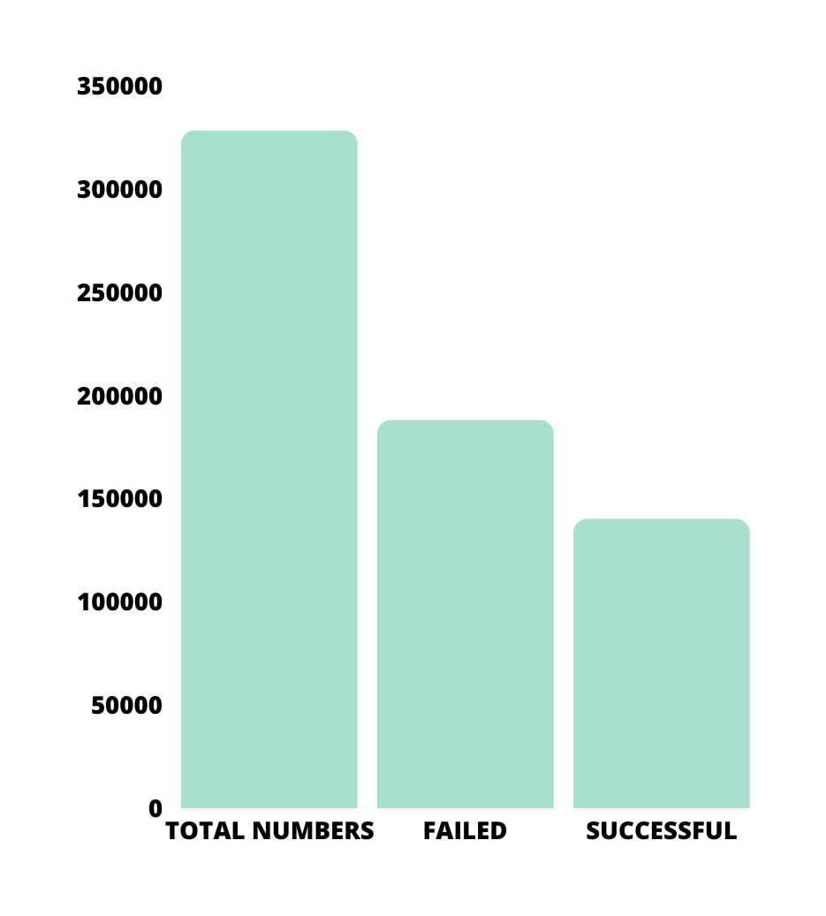
Data Overview
Total number of projects analyzed: 328,492
Successful projects count (2009-2019): 140,282
Failed projects count (2009-2019): 188,210

Slide 4
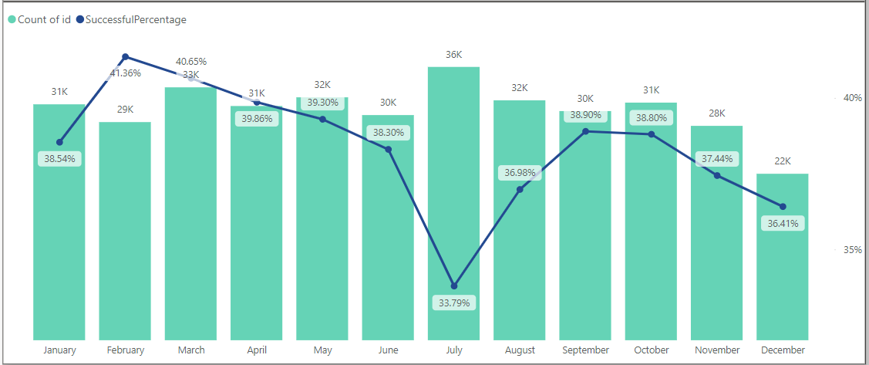
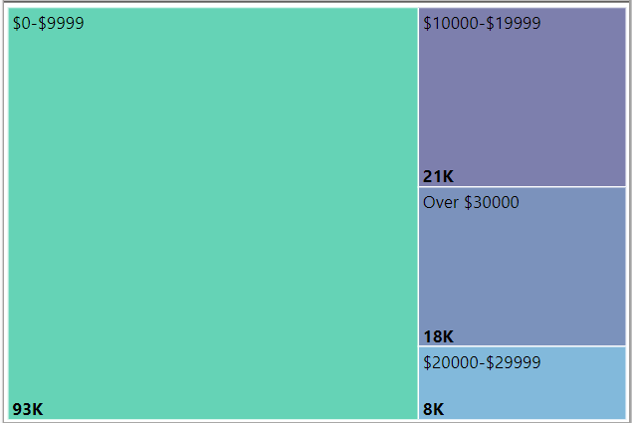

Factors Influencing Project Success
MONTHLY TREND
GOAL RANGE

Slide 5

Key Findings
01.
03.
Realistic Funding Goals: Success rate of projects with a funding goal range between $0-$9999: 45.83%
Geographic Insights: Most projects and successful projects originated from the U.S., with a success rate of 39.25%. However, the success rate in G.B. was slightly higher at 40.59%, despite fewer projects.
02.
04.
Optimized Campaign Duration: Higher success rate observed for projects with a campaign duration between 20-30 days
Seasonal Trends: December, July, and August experienced a drop in the count of successful projects, while February, March, and September had the highest percentage of successful projects.

Slide 6
Recommendations
Based on the findings:
Realistic Funding Goals: Encourage creators to set funding goals within the $0-$9999 range to align with higher success rates.
Optimized Campaign Duration: Recommend a campaign duration of 20-30 days to maximize success rates.
Geographic Insights: Tailor marketing efforts to target regions with higher success rates, such as the U.S. and G.B.
Seasonal Trends: Adjust project launches to coincide with months experiencing higher success rates (February, March, September).
01.
02.
03.
04.

Slide 7

Presented by Ajay Meena
Thank you very much!

